Slide 1
IBM University Engagement Project Submission
“Exploring the Power of Agentic AI with IBM Granite and IBM Bob”

Slide 2

Project Tile – EduIntegrity AI – Context-Aware AI-Driven Plagiarism Intelligence and Academic Integrity System
Problem Statement No.10 – AI-Driven Plagiarism Intelligence for Assignments
Domain of Project – Education
Student Name | Recent Passport Photo | Email ID | Mobile number [WhatsApp]
Uzair Javaid Rather AICTE STUID: STU69f338bd4f21e1777547453 |  | ratheruzair83@gmail.com | 6005906613

Slide 3
Problem Statement -
Problem Statement : AI-Driven Plagiarism Intelligence for Assignments
The Challenge
Academic integrity enforcement in educational institutions is often manual, inconsistent, and time-consuming. Instructors struggle to efficiently detect suspicious similarities, unusual writing patterns, and possible AI-assisted submissions across large volumes of assignments. Existing approaches are often limited to basic plagiarism checks and do not provide explainable, evidence-based insights that help instructors make informed decisions.
The Objective
The objective of this problem statement is to highlight the need for an intelligent and reliable system that helps instructors detect potential academic integrity issues in student assignments more efficiently and accurately. It aims to define the core challenge, the limitations of current manual or basic automated methods, and the desired outcome of a transparent, evidence-based solution that supports fair academic review.

Slide 4
Proposed Solution -
EduIntegrity AI will be developed as a web-based academic integrity analysis platform that helps instructors review student submissions using multiple evidence-based indicators instead of relying on a single plagiarism score. The system will process uploaded assignments, extract text, compare submissions against reference content, analyze writing patterns, and present a transparent risk report with explanations for each finding.
Key Components -
- Document ingestion and text extraction for PDF, DOCX, and TXT files
- Lexical similarity analysis using TF-IDF and cosine similarity
- Semantic similarity analysis using sentence embeddings
- Writing-style analysis based on measurable linguistic features
- Historical anomaly detection using past student writing patterns
- Citation anomaly detection and AI-authorship indicators
- Risk score generation with weighted scoring across all dimensions
- IBM Granite-powered explanation layer through watsonx.ai
- Instructor dashboard for reviewing evidence and final judgment
Workflow -
1. Instructor uploads an assignment.
2. The backend extracts and cleans the text.
3. The system analyzes lexical, semantic, style, citation, and historical indicators.
4. A weighted risk score is calculated.
5. IBM Granite interprets the structured evidence and generates a natural-language explanation.
6. The instructor reviews the evidence, score, and explanation before making the final academic decision.

Slide 5
Technology Used
EduIntegrity AI uses a combination of web, backend, AI, and analysis technologies to build the academic integrity platform.
Frontend-
HTML
CSS
JavaScript
Backend-
Python
FastAPI
AI and Analysis-
IBM Granite
IBM watsonx.ai
scikit-learn
sentence-transformers
TF-IDF and cosine similarity techniques
Deployment and Support-
Docker
Docker Compose
GitHub for version controI

Slide 6
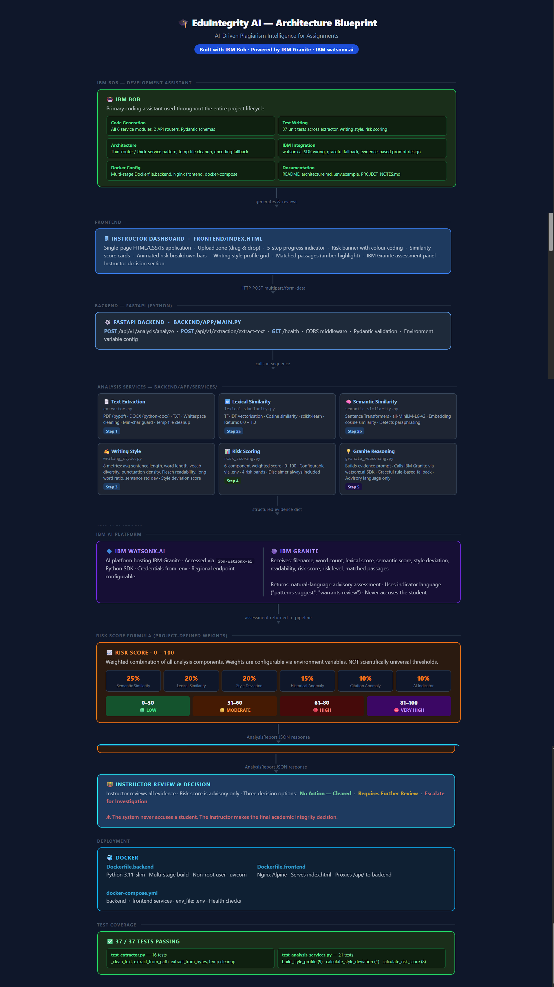
Blueprint of the Project -

Slide 7
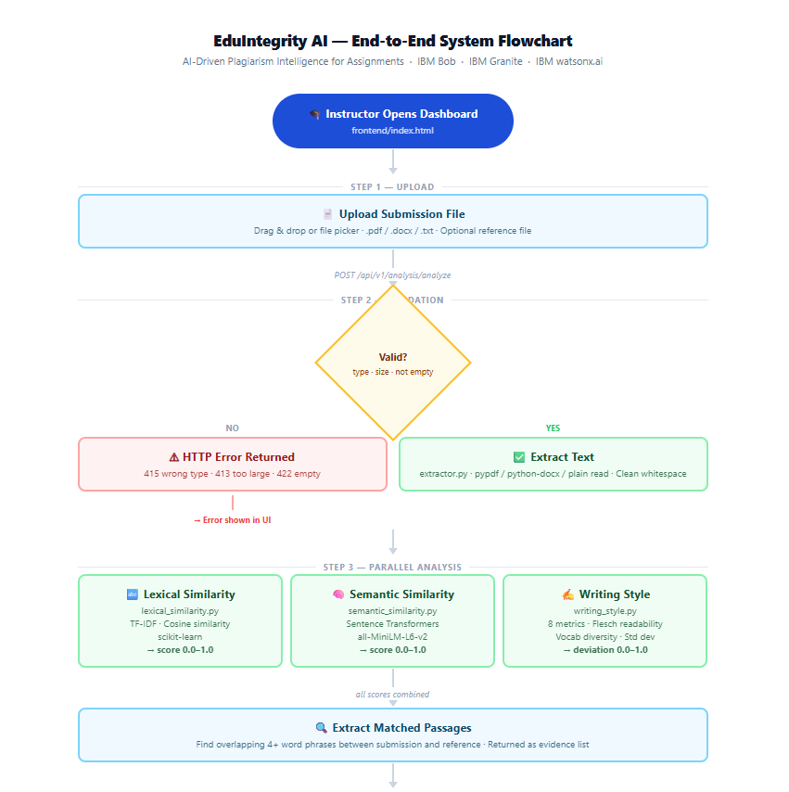
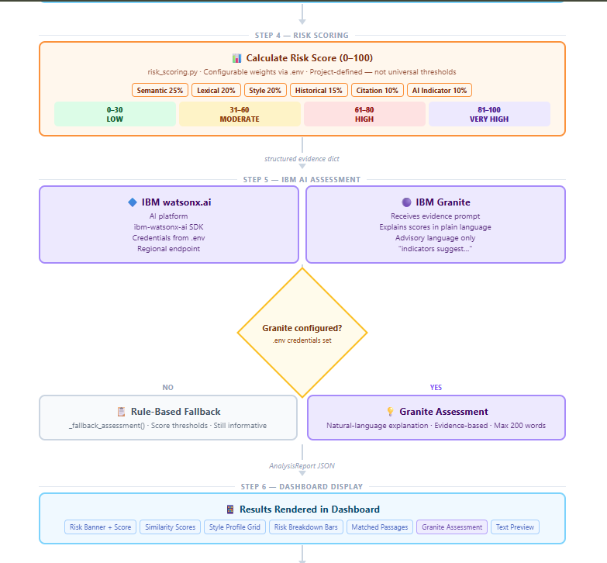
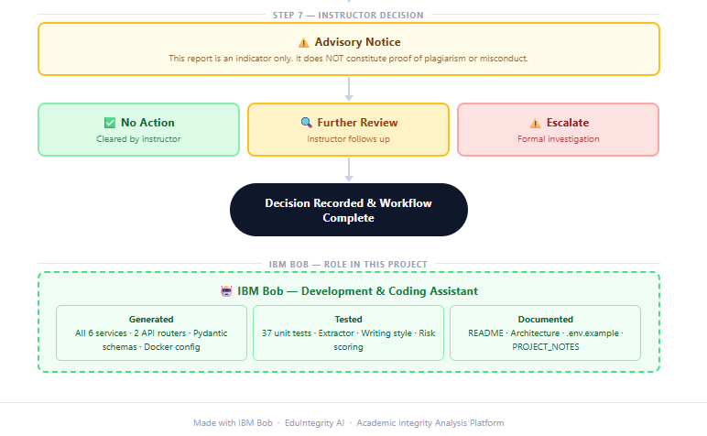
Control Flow of the Project -

Slide 8
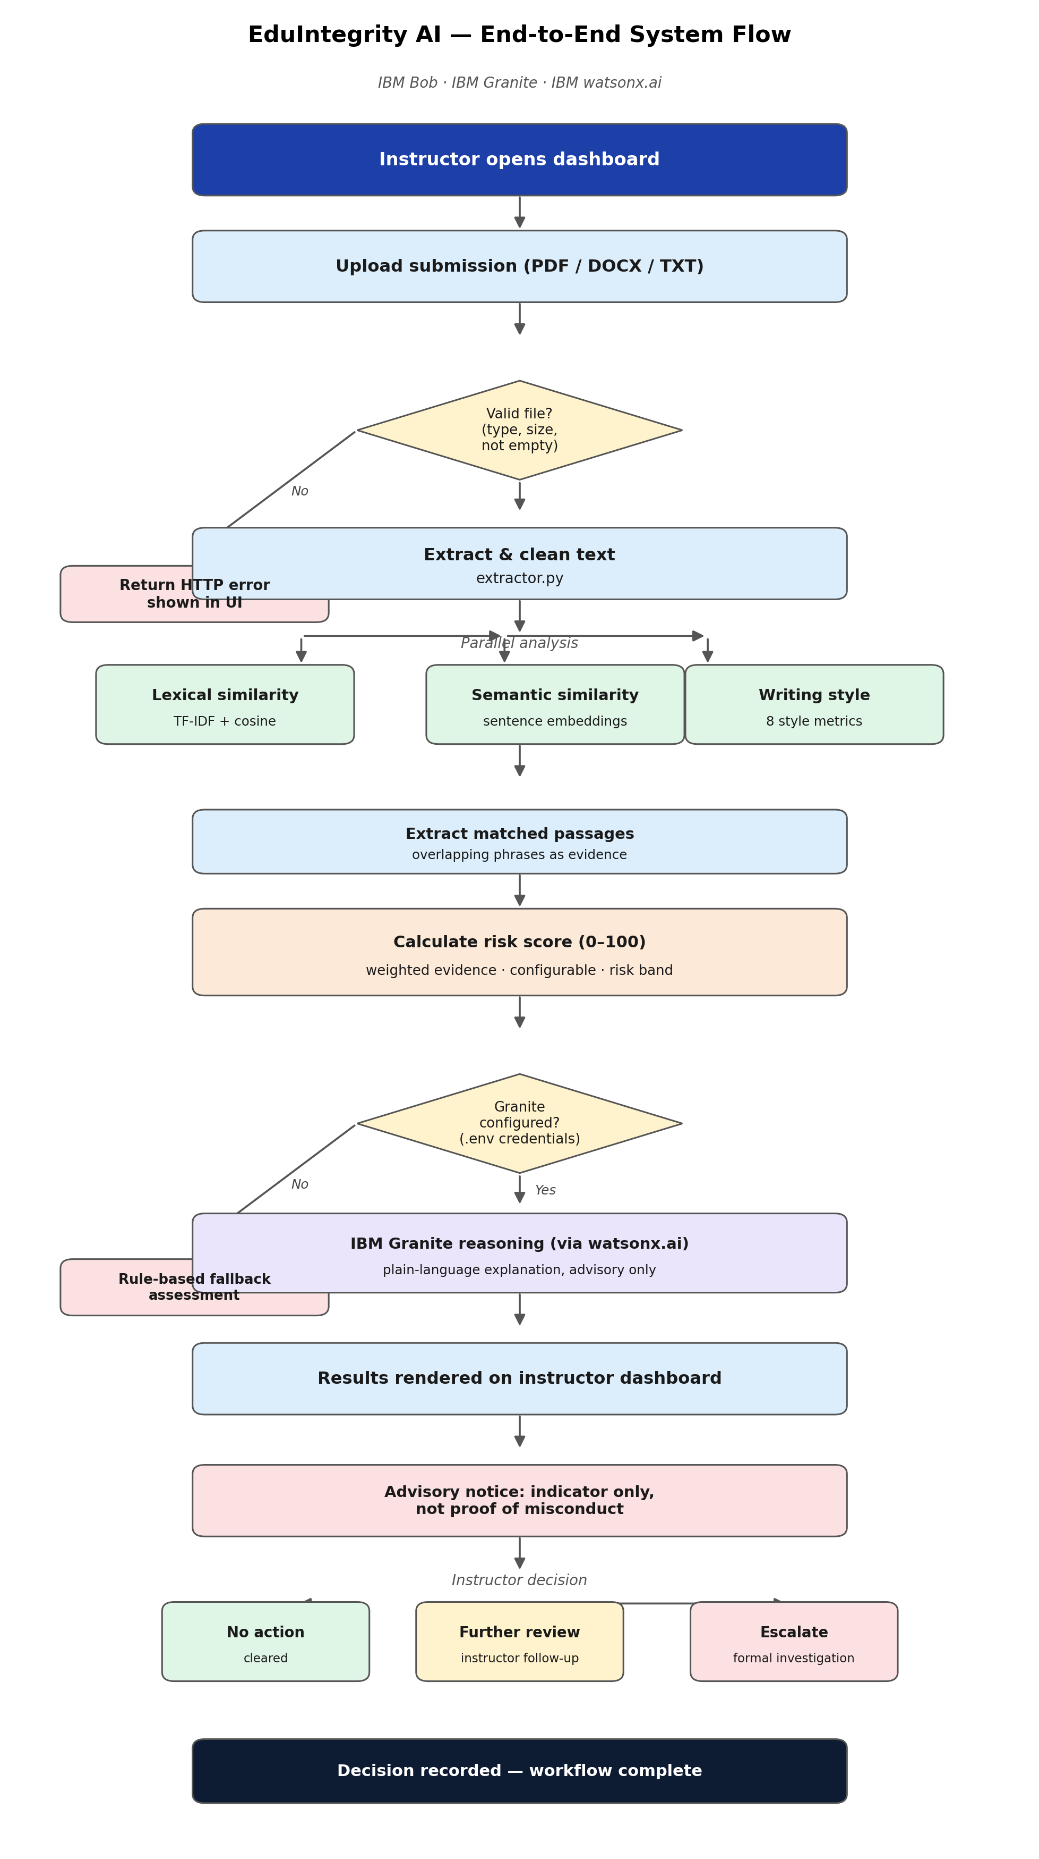
Control Flow of the Project -

Slide 9
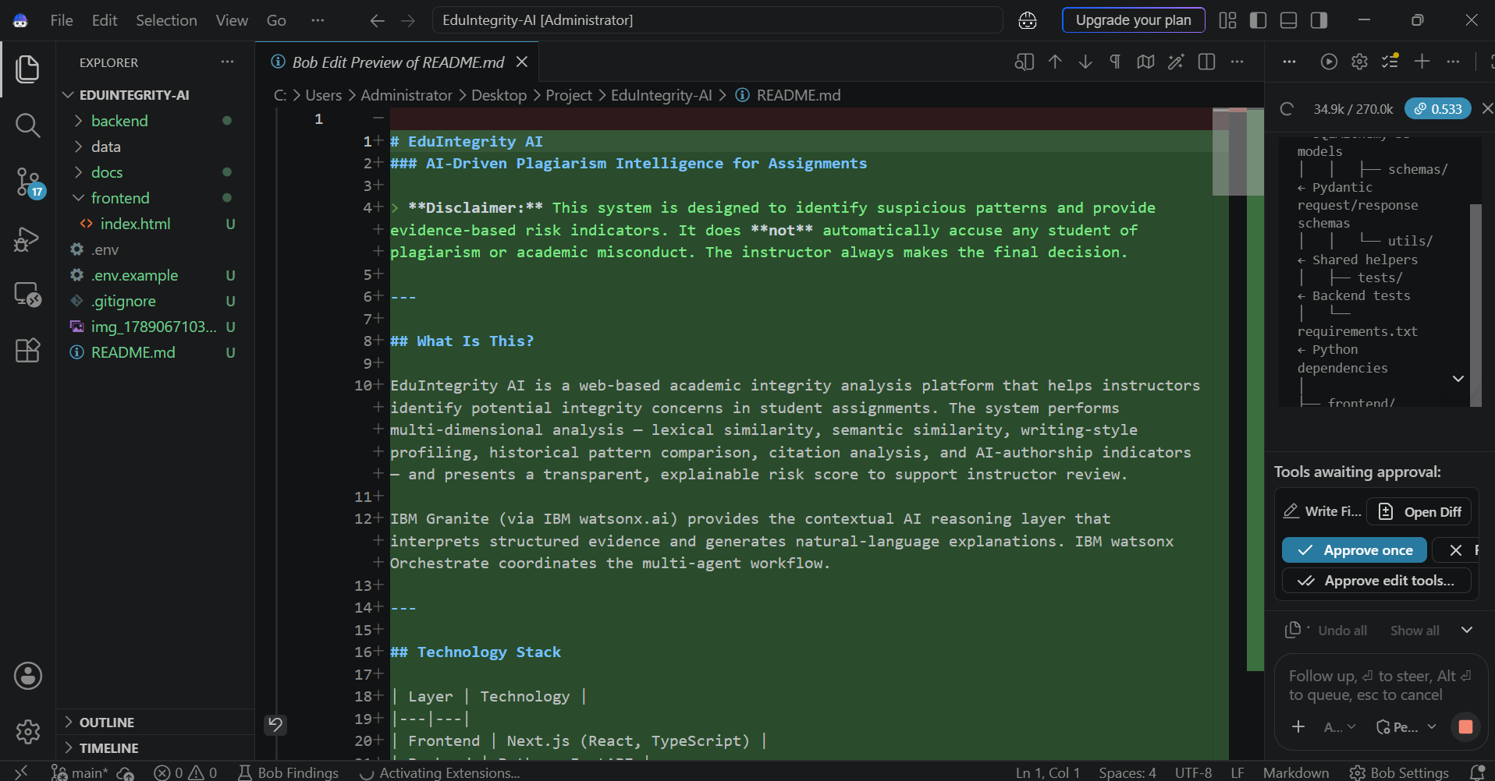
Required Files created using IBM bob -

Slide 10
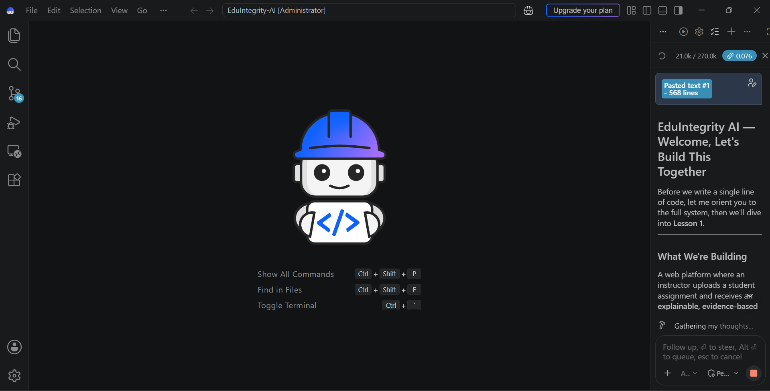
IBM Bob Screenshots:

Slide 11
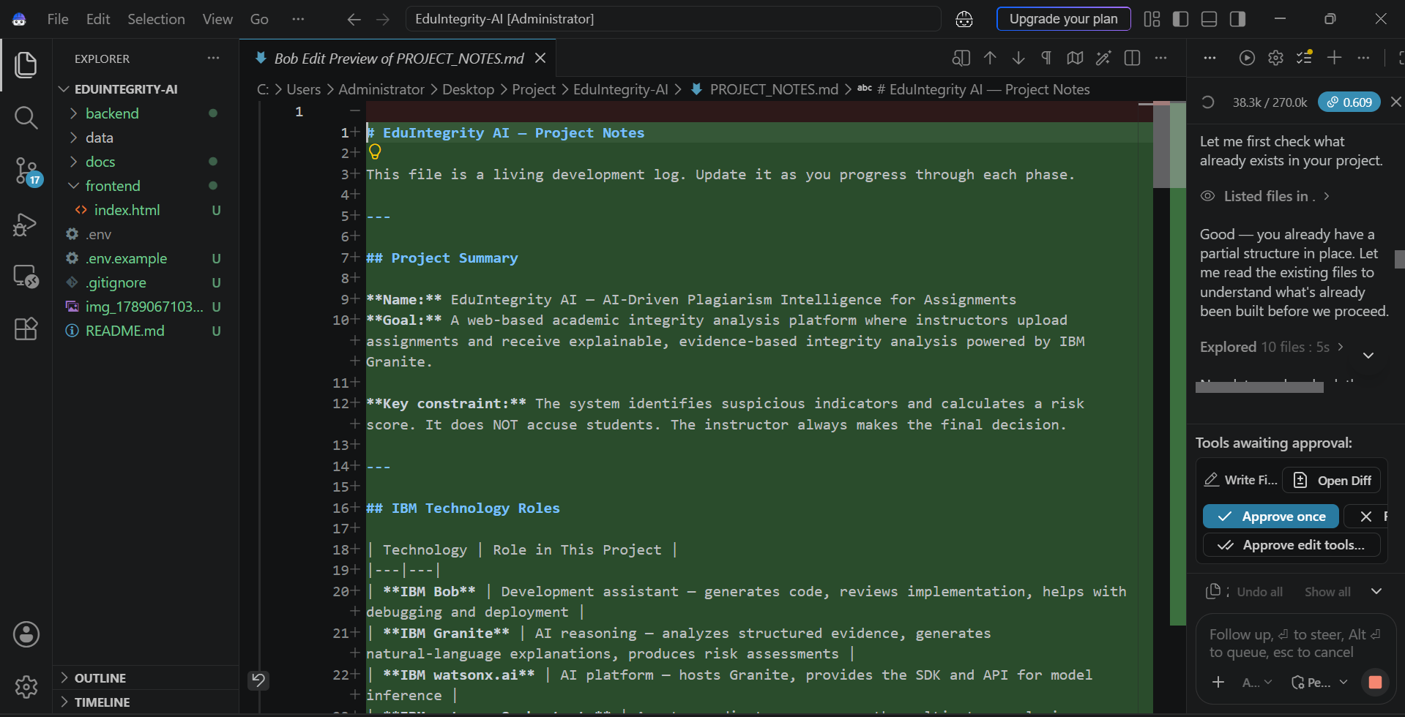

Slide 12
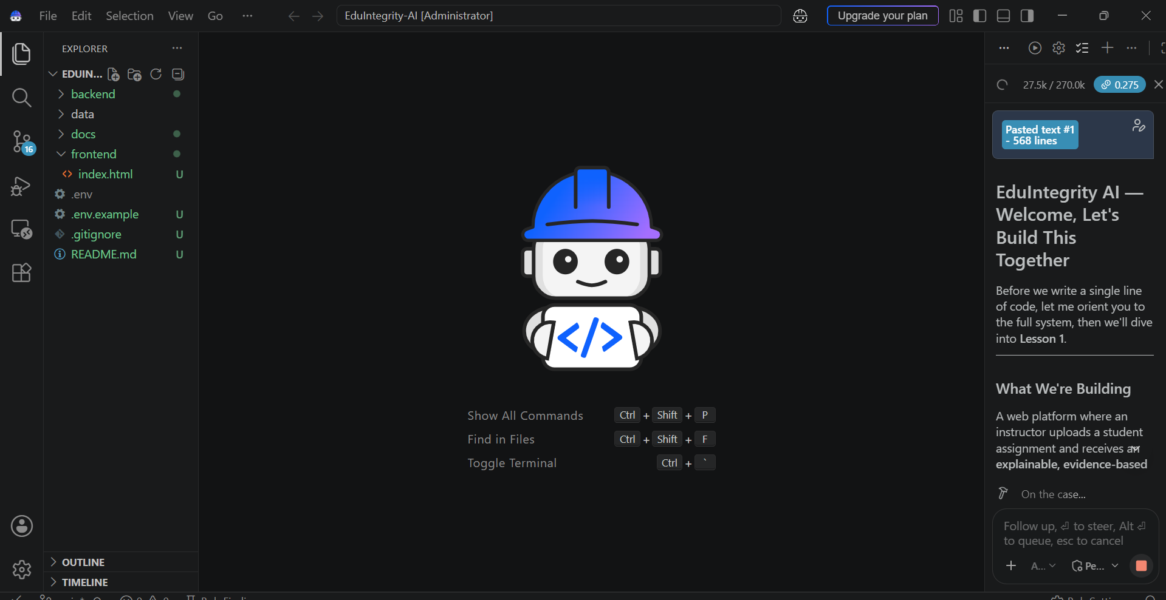

Slide 13
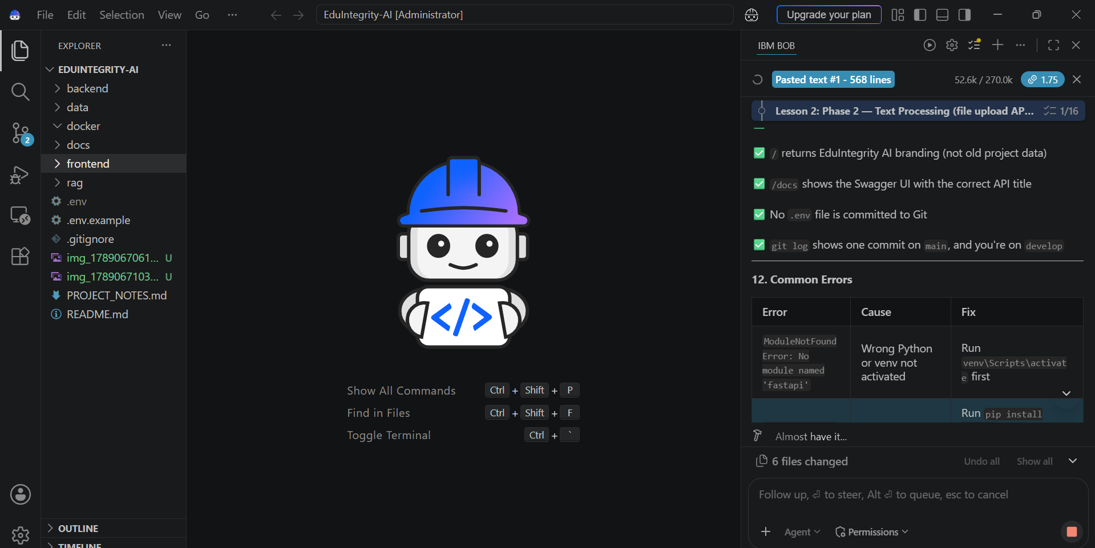

Slide 14
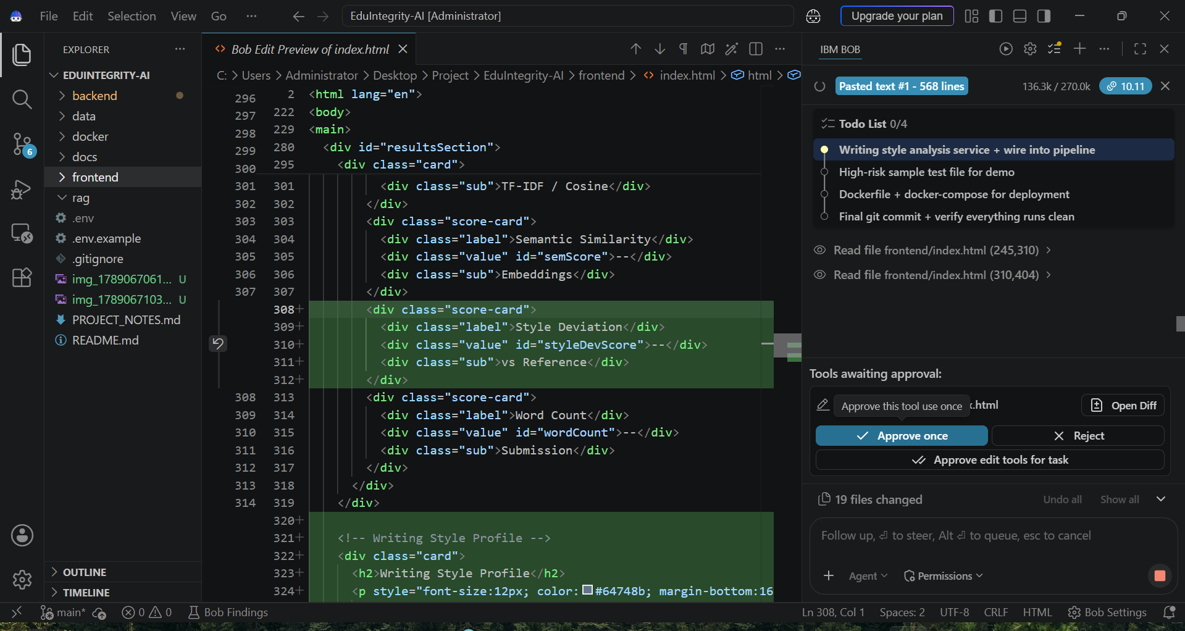

Slide 15
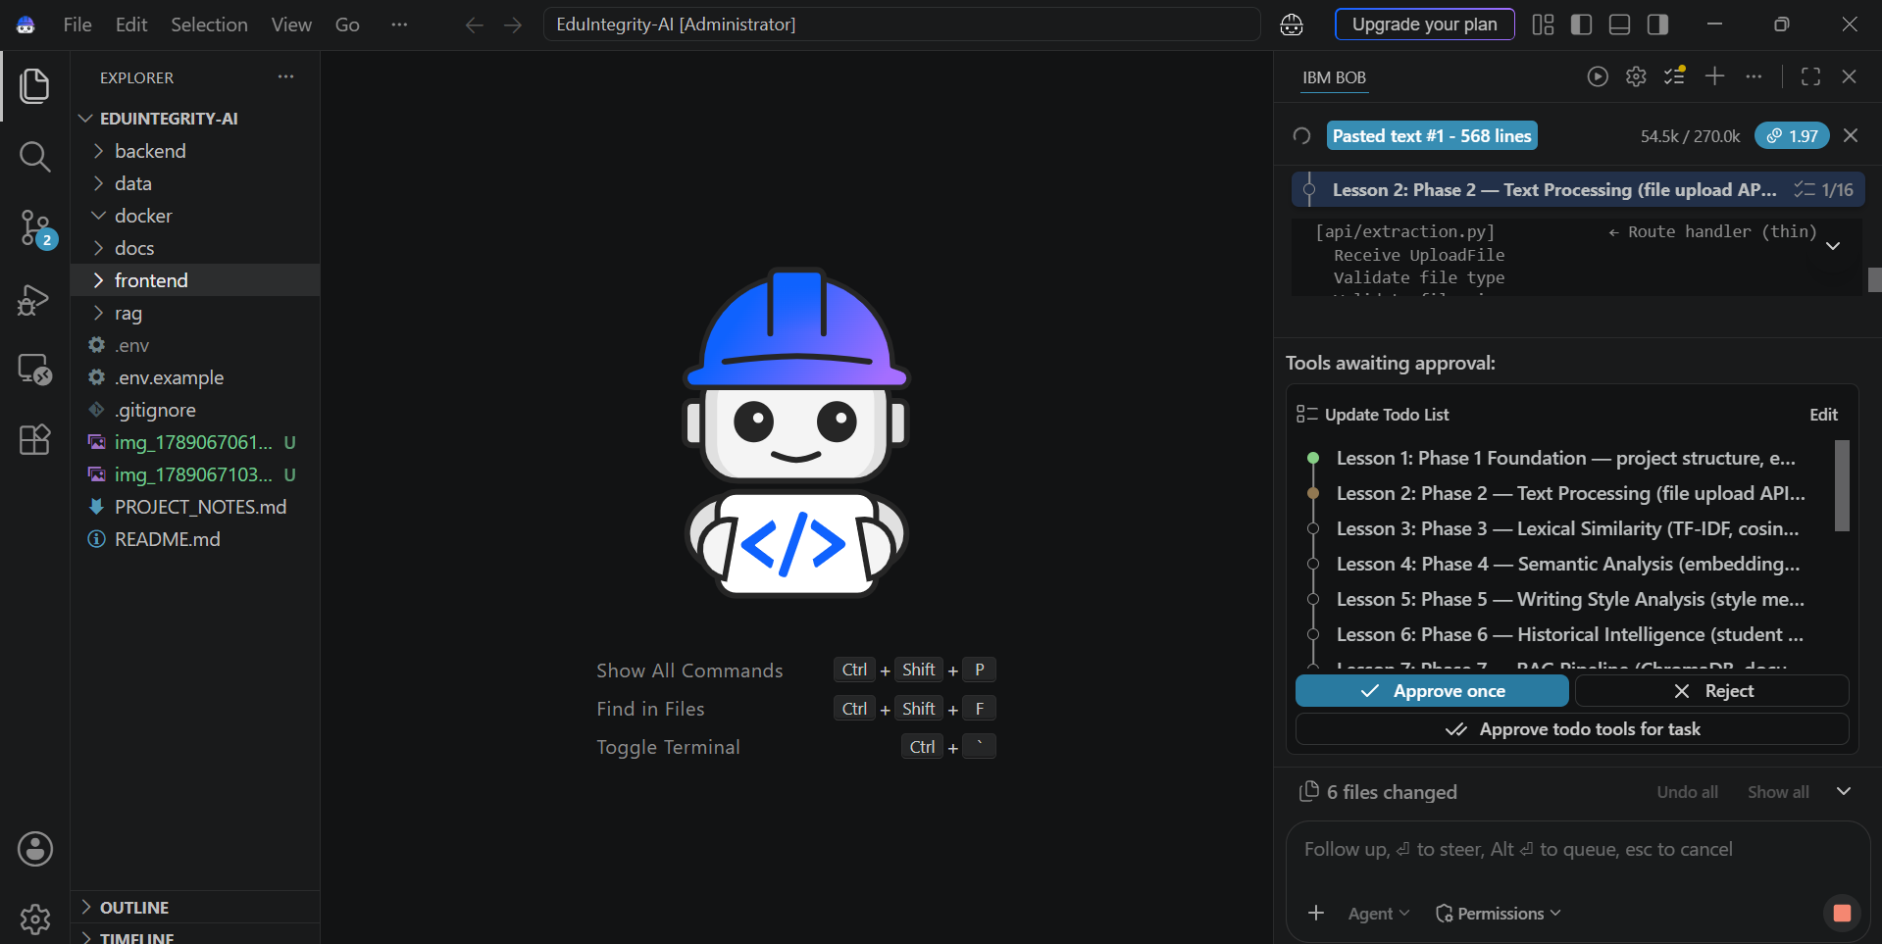

Slide 16
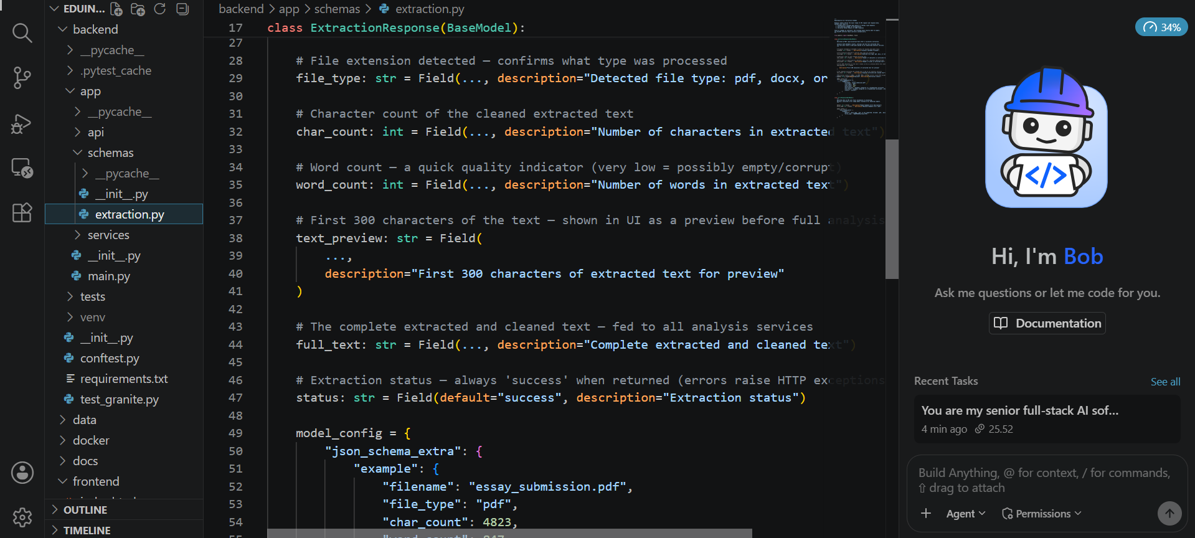

Slide 17
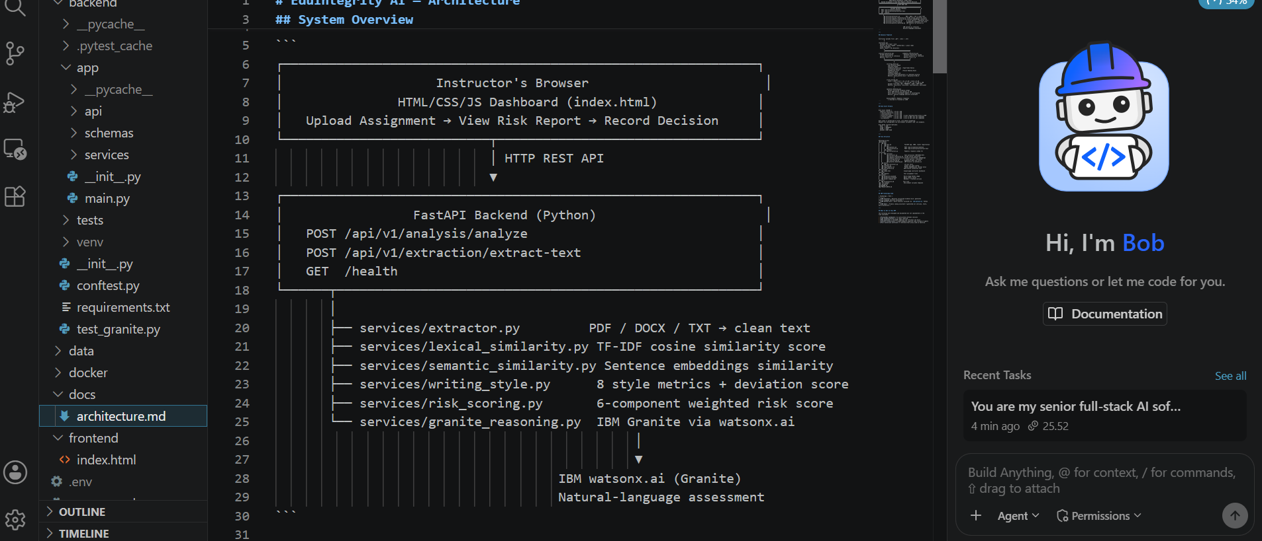

Slide 18
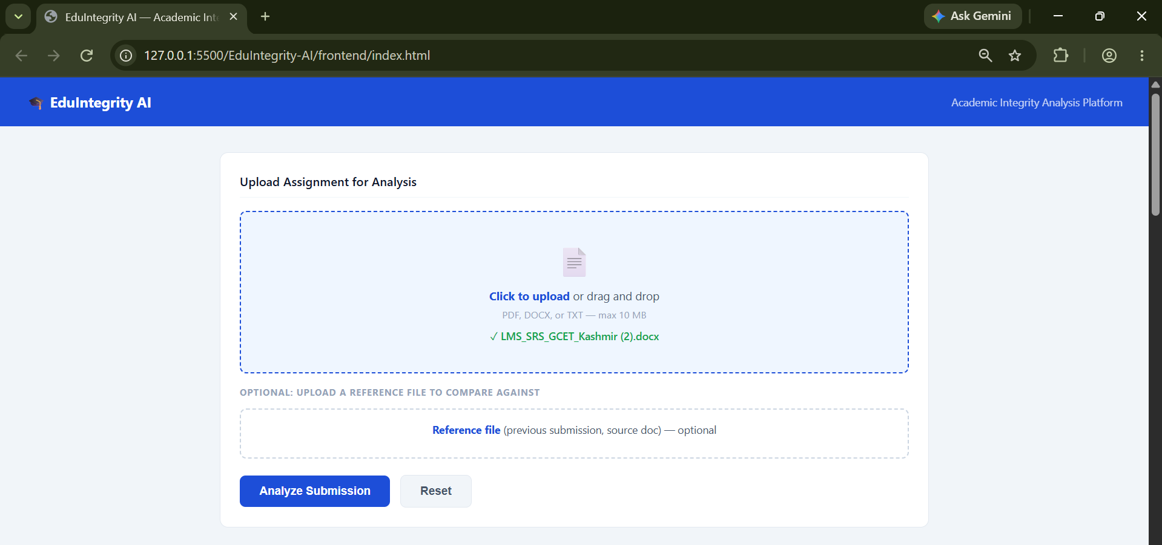
Web App Interface built by IBM bob:

Slide 19
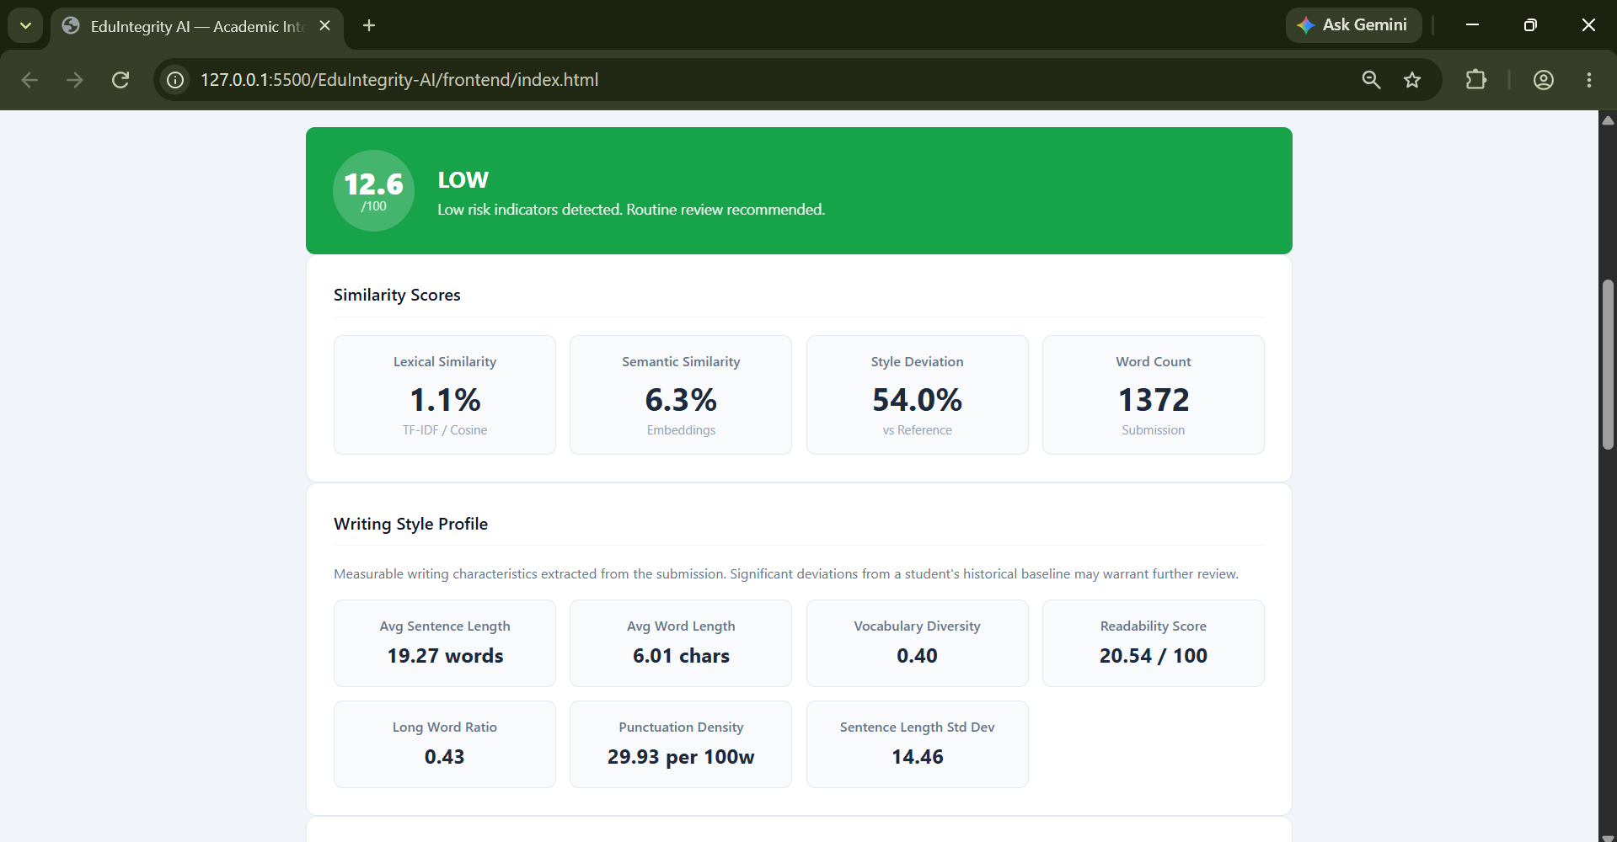

Slide 20
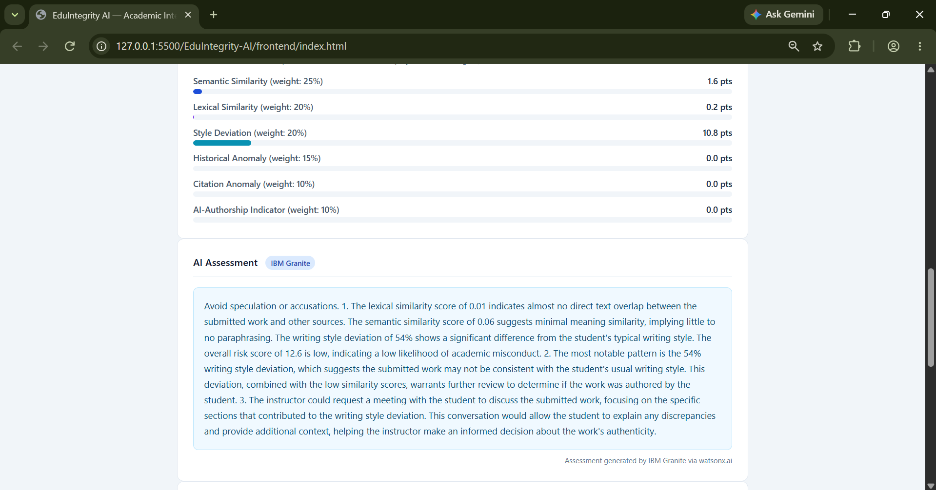

Slide 21
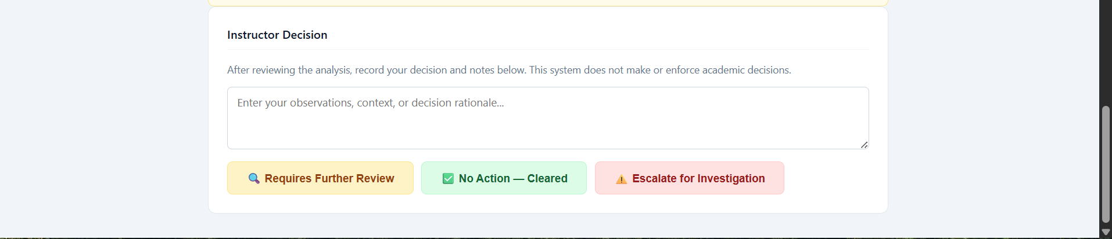

Slide 22

Role of Agentic AI in the solution
The agentic agent in EduIntegrity AI plays the role of an intelligent coordinator that manages the analysis workflow automatically.
Main Role-
It connects different modules such as:
text extraction
lexical similarity analysis
semantic similarity analysis
writing-style analysis
historical anomaly detection
risk scoring
IBM Granite explanation generation
What It Does-
- Receives the uploaded assignment
Triggers the required analysis steps in sequence
Collects results from each module
Combines them into a structured evidence package
Sends the final results to the instructor dashboard or AI reasoning layer
Why It Is Important-
Reduces manual effort- Makes the system more automated and efficient- Improves consistency in how analysis is performed- Helps generate explainable results instead of only raw scores
In This Project-
IBM Bob acted as the development agent during implementation- IBM Granite handled AI reasoning- IBM watsonx Orchestrate would be the agentic orchestration layer for coordinating multi-step analysis in a more advanced setup

Slide 23
Novelty and Uniqueness
The novelty of EduIntegrity AI lies in its combination of multiple academic integrity analysis techniques in a single, explainable system. Unlike traditional plagiarism checkers that mainly focus on word overlap, this project evaluates submissions through several dimensions, including lexical similarity, semantic similarity, writing-style deviation, historical anomaly detection, citation irregularities, and AI-authorship indicators.
What Makes It Unique-
Multi-dimensional analysis instead of only text matching - Explainable risk scoring with evidence-based reasoning - Integration of IBM Granite for natural-language interpretation - Focus on instructor decision support rather than automatic accusation - A combined pipeline that brings AI, NLP, and academic review together in one platform.
Why It Is Valuable
This makes the project more practical and trustworthy for educational settings, because it helps instructors understand not just whether a submission is suspicious, but also why it appears suspicious and which indicators contributed to the risk score.If you want, I can also turn this into a short paragraph for your report or presentation.

Slide 24
Git Hub Link
https://github.com/UzairJavaidRather/EduIntegrity-AI.git
To Access the Repo :- CLICK HERE
·
·
·

Slide 25
Future Scope
The future scope of EduIntegrity AI includes expanding the system from an MVP into a more advanced academic integrity platform. Some possible enhancements are:-
Integration with a database for storing student history and past submissions
Authentication and role-based access for instructors, administrators, and students
Support for larger datasets and batch processing of multiple assignments
Advanced retrieval-augmented analysis using vector databases
Improved AI-authorship detection with more reliable academic indicators
Integration with learning management systems such as LMS platforms
Automated reporting, dashboards, and exportable review summaries
Deployment on cloud platforms for scalable real-world use
These improvements would make the system more efficient, scalable, and suitable for institutional adoption.
·
·
·

Slide 26
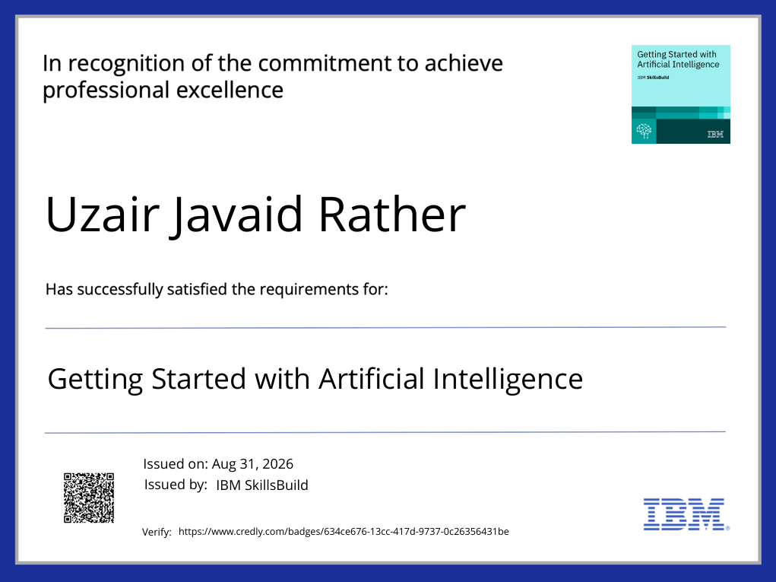
Certificates Earned:
(Getting Started with Artificial Intelligence)

Slide 27
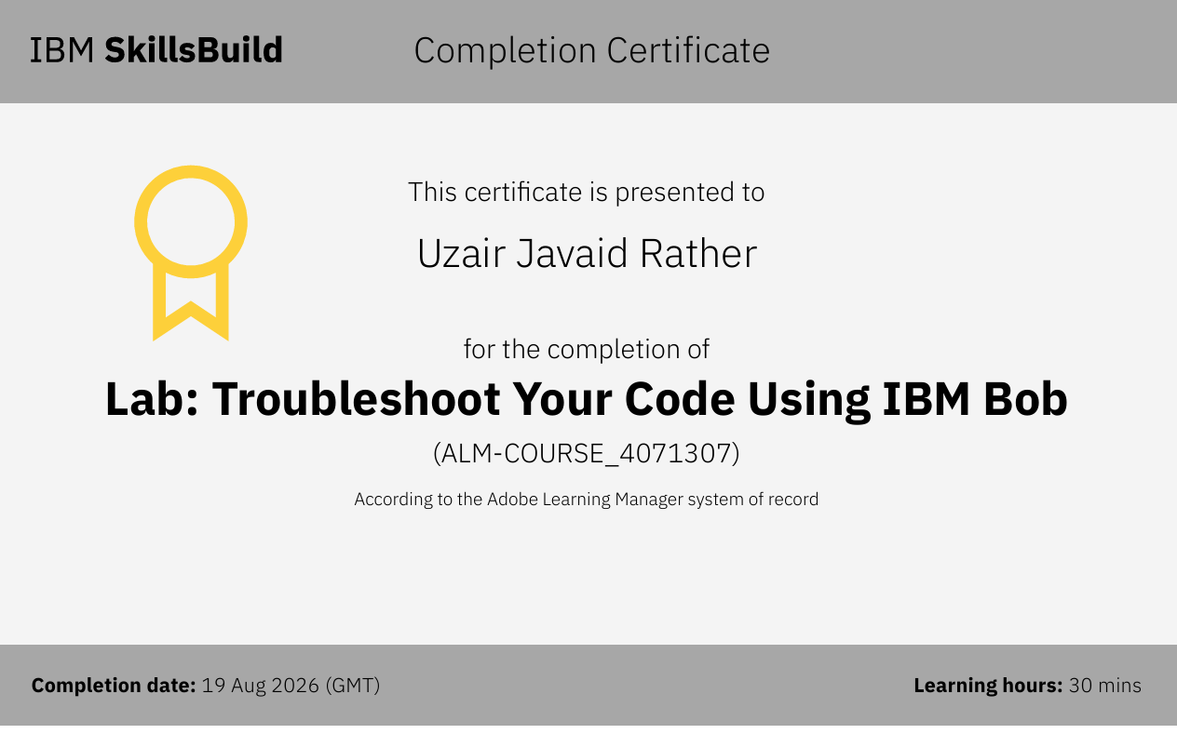
Certificates Earned:​
Add your IBM BOB Certificate

Slide 28
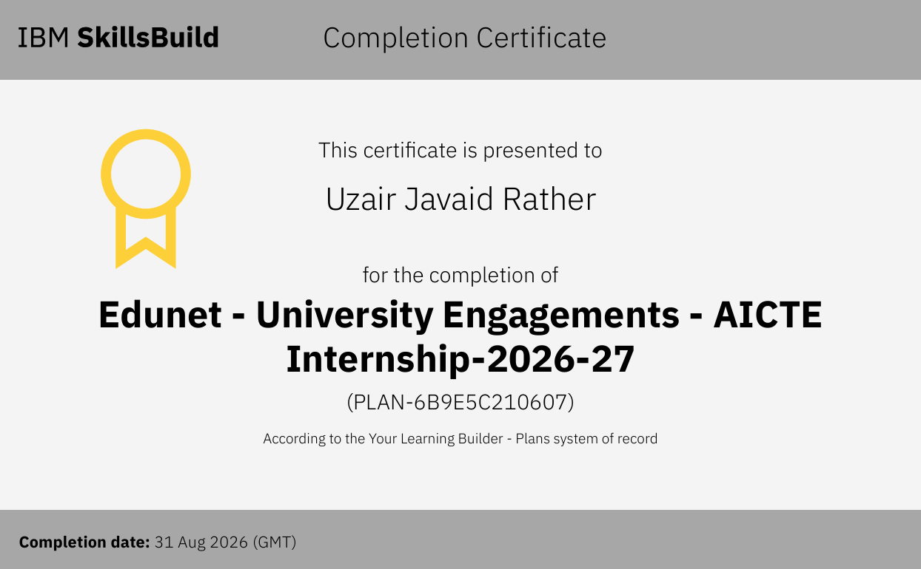
Certificates Earned:​

Slide 29
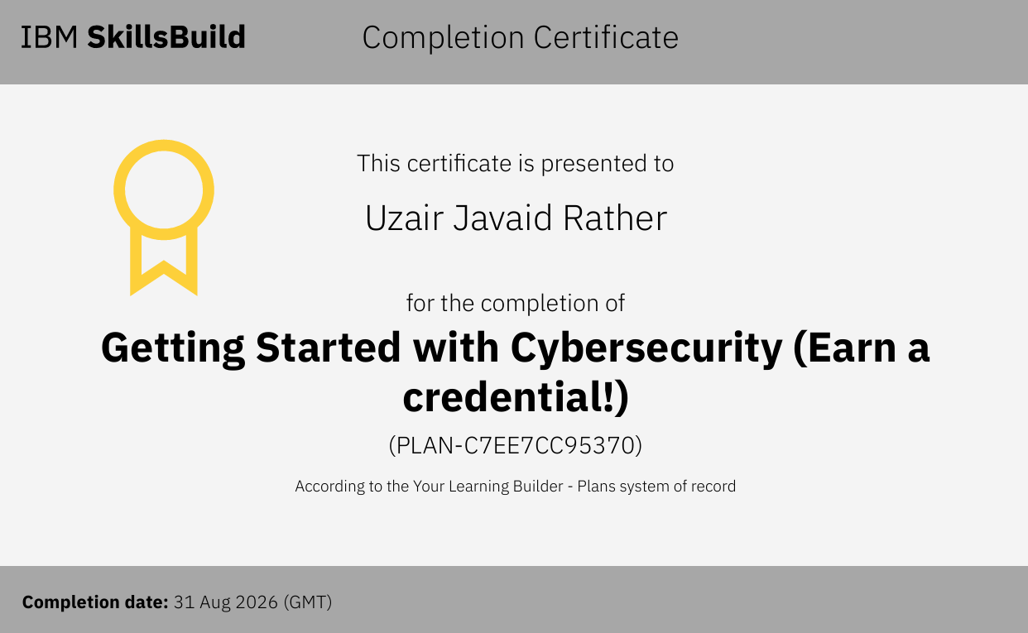
Certificates Earned:​

Slide 30


